Slide 1
Welcome to Analytics for Business by Ralf Martin (r.martin@imperial.ac.uk)

Slide 2
Course objective
Equip you with basic data analysis tools used in economics and business.
Expect to get your hands dirty with data and coding.

Slide 3

Why should you study for this course?
Data is everywhere and as an consultant or analyst you need to be able to draw conclusions from data
Even if you have people who will do the analysis for you its vital to understand how conclusions are derived and what they mean.
You most likely will have to deal with developers in your career. To do that effectively you need a basic grasp of coding.

Slide 4

Your lecturer
PhD in Economics from the London School of Economics
Name: Ralf Martin
Office: CAGB 487
Citizenship: EU
Pioneer in the UK of analyzing government business census data
Pioneer in using business census data to evaluate climate policy
Dad
Windsurfer

Slide 5

Your teaching assistant
Yuan Hu
y.hu18@imperial.ac.uk

Slide 6
Assessment
Always remember: Genuine Questions are never dumb
5% Participation (on Datathon or Insendi Forum)
60% Assessed exercise.
35% Final Group Coursework:
Find question or issue that can be informed by data
Find data (at 50 observations)
Conduct analysis providing relevant evidence
Discuss findings appropriately
Will provide further instructions soon
Basically we will check if your hands are dirty

Slide 7
The plan
Week | Topic
Week 1 | Introduction
Week 2 | Rrrr | Zoom tutorial
Week 3 | Visions
Week 4 | Testing times | Zoom tutorial
Week 5 | Multivariate Regressions | Hand in Group Coursework outline
Break
Week 6 | Econometrics for Dummies | Zoom tutorial
Week 7 | Instrumental Variables
Week 8 | Learning like a machine | Zoom tutorial
Week 9 | Time for series
Week 10 | Loose Ends | Zoom tutorial

Slide 8

Guest lecturer (tbc)
Yves-Alexandre de Montjoye
www.demontjoye.com
Will tell you everything you ever wanted to know about machine learning

Slide 9

Introduction – Data Stories
Converting data into something beautiful

Slide 10
Introduction
In Business and Economic decisions making we (ideally) need to base decisions on evidence
Sometimes case studies & anecdotes
More often: vast amounts of data
Consumer purchase decisions
Data for many different countries over long periods of time
Behaviour of workers: job search, unemployment, wages
Data on business outcomes
To make sense of this there is (traditionally) a sub discipline called
Econometrics = Statistics + Economics
Closely related: Biometrics, Data Science, Epidemiology

Slide 11

A secret:
What makes a good data analyst or econometrician?
Mathematical skills?
Programming skills?
These are helpful, however a key ingredient is also to be an imaginative story teller.
This will help you to
Have a clear idea of the story you want to explore with data
2. Have an understanding of the story of the data
What are the potential drivers that could have produced your data?

Slide 12
An important tool
Our story
Data story
(Econometric or Statistical)
Model
Draw conclusions about the validity of our story
But also: understand to what extent our knowledge might be inconclusive

Slide 13


What is a Model?
A verbal or mathematical description of relationships between things we can (potentially) measure

Slide 14
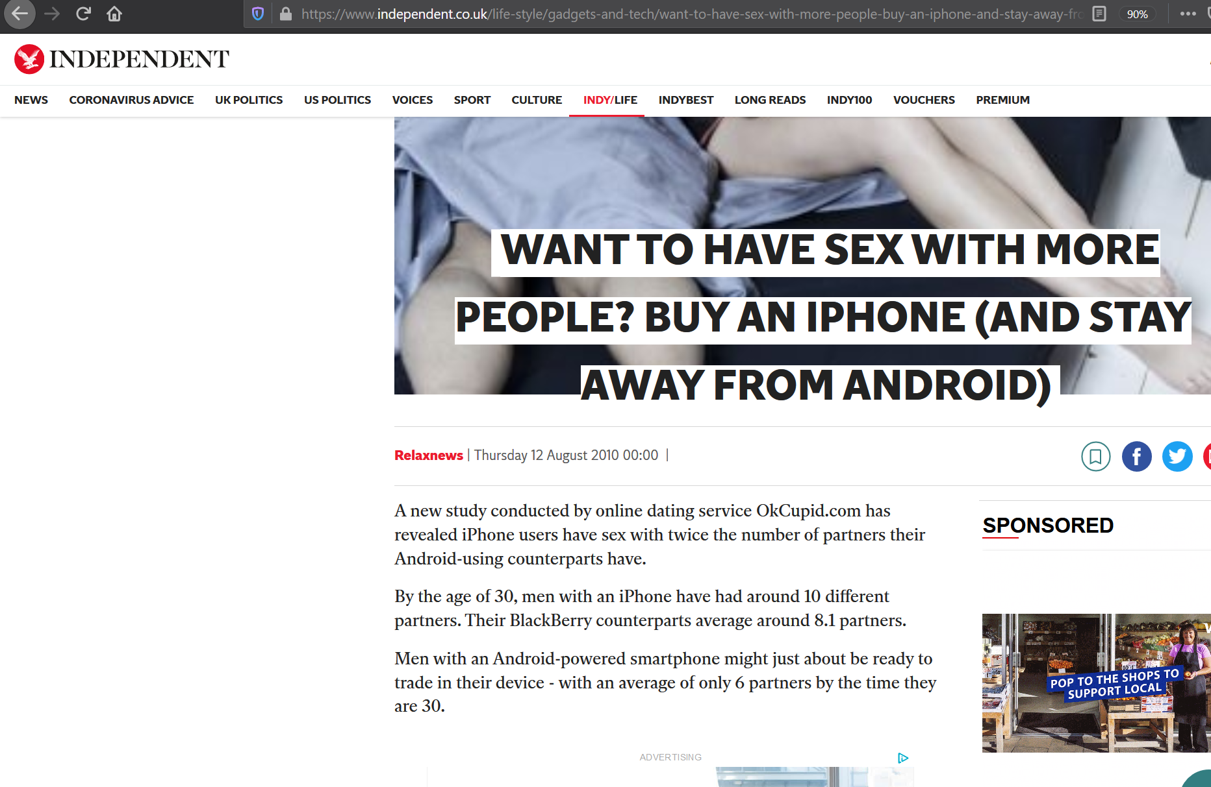
For example:
Sex with 10 vs 6 people

Slide 15


What’s the Independent’s (our) story?
It’s about causal (not casual) relationships
Say it with arrows (your first econometric model):
+
iphone
Amount of Sex
Using arrows we can express causation: iphone causes more (as indicated by the +) sex amount
It also important to think of potential reasons for such a relationship; e.g. iphone signals wealth, style, taste ….? (Really?)

Slide 16


What could be the story of the data?
Your suggestions please?
+
Another factor (e.g.) money drives both iphone ownership and sex
+
+
We need both arrows for there to be a problem!!
Note:
Because Money is positively related to both sex and iphone ownerhsip we would see a positive correlation between the two in the data even if there is no causal effect from iphone to sex
If there is a positive causal effect from iphone to sex, the money effect would make it seems stronger (we see the combined effect of money and iphone in the data)
Upward bias: Our estimated effect is larger than the true one

Slide 17


Another potential data story:
Time
-
+
+
Hard Work
- /+
+
(Good) Sex takes time
To make money (some of us) have to work hard, which leaves us less time
Hence, it is possible that people with more money have less time and less sex.
If they also buy more iphones we could expect to find a dataset where iphone usage is negatively correlated with sex
If we find a dataset with a positive correlation this would imply that the actual causal effect is even larger
Downard bias: Our estimated effect is smaller than the true one

Slide 18
What is the problem and what could be a solution?
-
+
+
+
Hard Work
- /+
+
Endogenous Variation →Endogeneity Problem
Key Problem: The explanatory variable of interest (iphone) is driven by factors (e.g. money) that exert their own causal effect on the outcome variable of interest (sex)
Hence, to get an unbiased estimate of the causal effect of iphones we need a dataset where variation in iphone ownership is not driven by such factors
How?
Instead we need Exogenous Variation

Slide 19
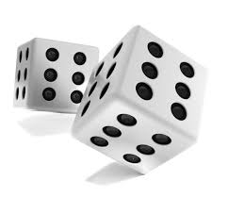

Randomized Control Trials (RCT)
How about giving people iphone’s at random to a “treatment group”?
Ensures that iphone ownership is not drivey by money or other factors
The data story is aligned with “our” story so our conclusions are informative about the story of interest.
Randomized Control Trials (RCT) increasingly common in economic/business research
Giving firms management practices
Energy consumption feedback
Fuel consumption feed to Airline pilots
Giving students in Hong Kong incentives to protest
Giving men in Saudi Arabia Information to induce them to let their wives work
But RCTs are not always feasible. What then?

Slide 20

Frome arrows to formulas
Using Arrows and +/- signs to describe relationships of variables is one valid modelling approach (also known as Directed Acrylic Graphs, DAG)
However, to come up with precise quantification of these relationships we need to start modelling with mathematical formulas

Slide 21


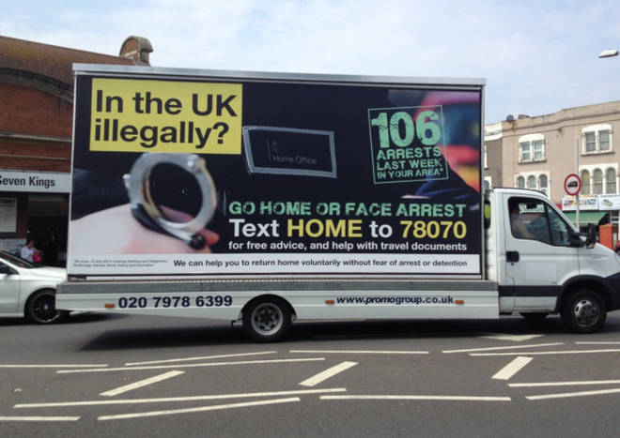
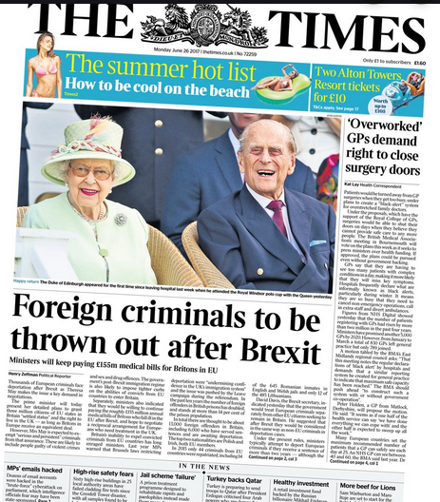
Another example: UK xenophobia in the UK
Since at least 2010 the UK government together with large parts of the media engaged in a virulent campaign of xenophobia and institutional discrimination against people without UK passports living in the UK. This involved blaming foreign born residents for all manner of things including crime.
Story: Foreigners cause crime

Slide 22
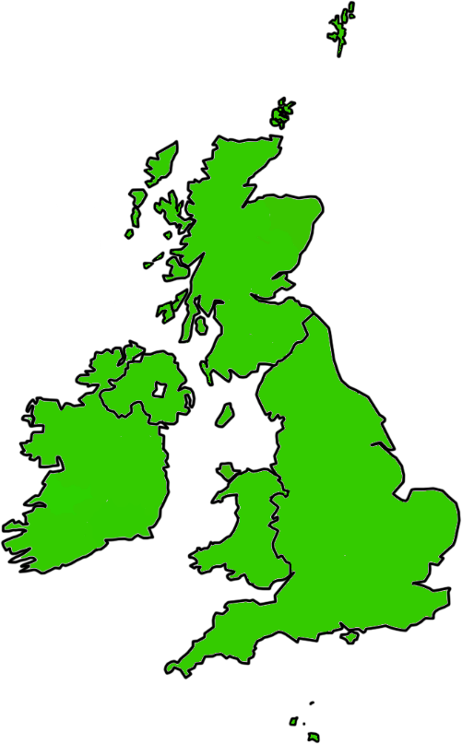

What data?
Hard to do RCTs here
Key to data is to have variation
Two basic ways
Between similar units: Cross Sectional Data
Same unit over time: Time Series Data
For the story at hand: Let’s look at local authorities (about 350) across the UK; i.e. Cross Sectional
Things need to change from one data point to the next

Slide 23
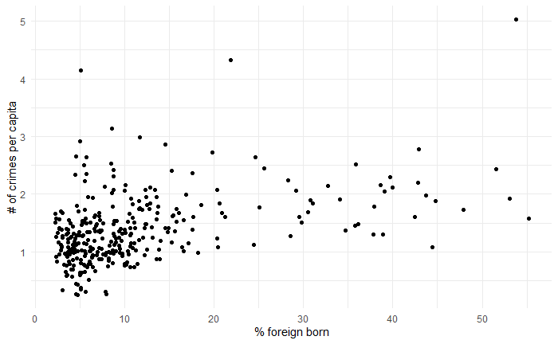
Crime and foreigners
Whenever we first look at data it is a good idea to make ourselves aware what is being measured exactly and what kind of units it is in
Correlation of 0.433
So what would you say? Should we blame foreigners for crime?

Slide 24

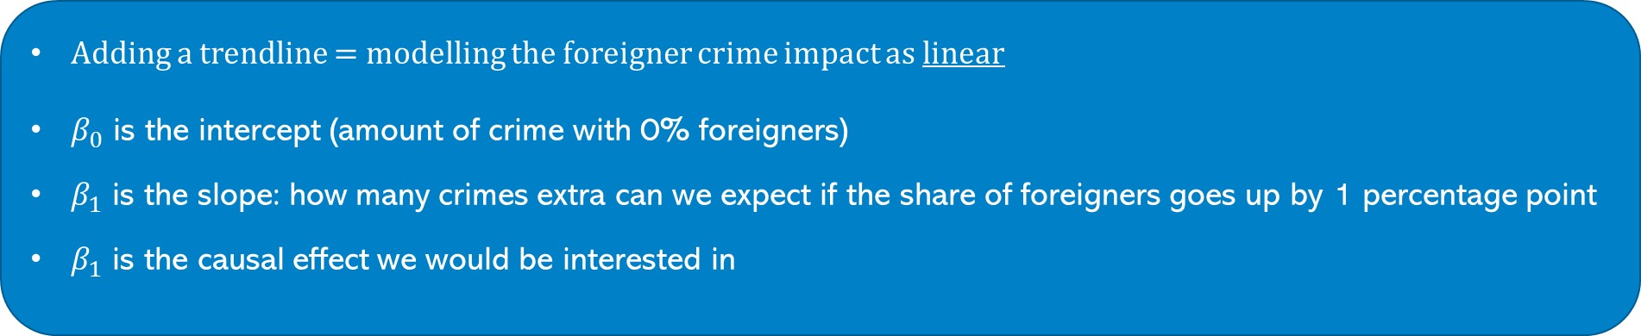
Adding a trendline = Modelling the data
Adding a trendline = modelling the foreigner crime impact as linear
$β_{0}$ is the intercept (amount of crime with 0% foreigners)
$β_{1}$ is the slope: how many crimes extra can we expect if the share of foreigners goes up by 1 percentage point
$β_{1}$ is the causal effect we would be interested in
Simplest case
$$Crime=β_{0}+β_{1}{foreign}_{}$$

Slide 25
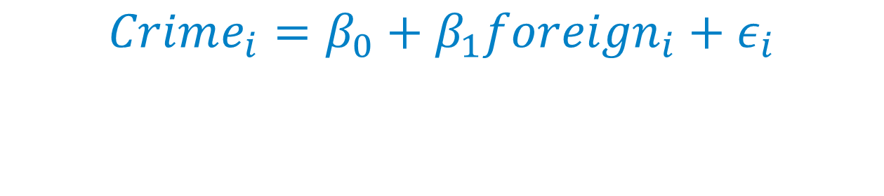
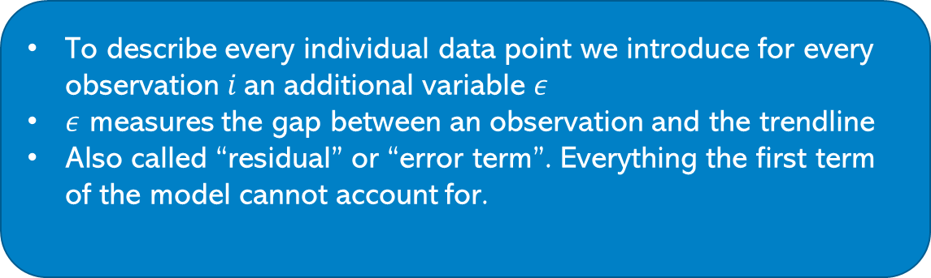
To really model the data we need to do a bit more:
To describe every individual data point we introduce for every observation $i$ an additional variable $ε$
$ε$ measures the gap between an observation and the trendline
Also called “residual” or “error term”. Everything the first term of the model cannot account for.
$$Crime_{i}=β_{0}+β_{1}{foreign}_{i}+ε_{i}$$

Slide 26

And a bit more: True model driving the data vs estimate
$$Crime_{i}={\hat{β}}_{0}+{\hat{β}}_{1}{foreign}_{i}+{\hat{ε}}_{i}$$
$$Crime_{i}=β_{0}+β_{1}{foreign}_{i}+ε_{i}$$

Slide 27

Reasons for differences between true model and estimated model
$$Crime_{i}={\hat{β}}_{0}+{\hat{β}}_{1}{foreign}_{i}+{\hat{ε}}_{i}$$
$$Crime_{i}=β_{0}+β_{1}{foreign}_{i}+ε_{i}$$
1. It’s based on a sample of finite data
That means we are wrong but not systematically wrong: i.e. we took another sample of similar data we are unlikely to make the same mistake
2. There could be confounding factors that make us systematically over- or under- estimate the actual parameters.
Sample Average $\frac{4+5+6+6+3}{5}$=4.8. Actual (True) Average: 3.5

Slide 28
The story of the data?
What are factors that could be driving the data (apart from foreigners being criminals)?
+
Foreigners
Crime
We would see a spurious + relationship
+
+
Big Cities=High Population
Foreigners could be attracted by bigger cities
Bigger cities have more crime
Foreigners
-
Crime
We would see a spurious - relationship
-
+
Unemployment
Foreigners often come to work
Hence they go to areas with less unemployment = more work, which also might have less crime

Slide 29


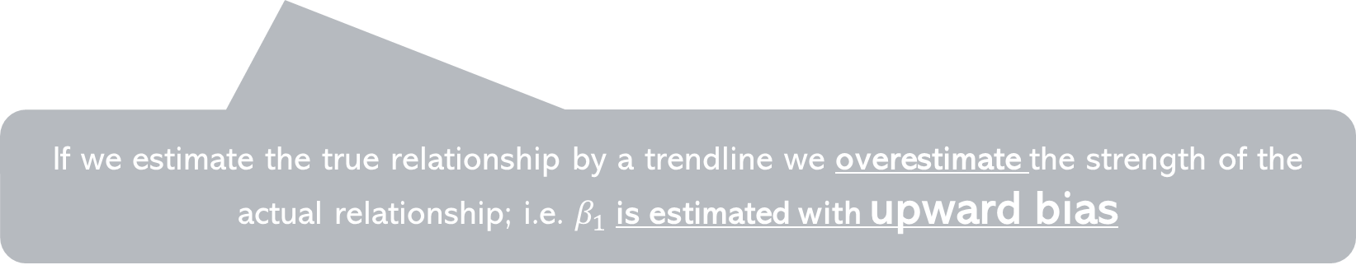
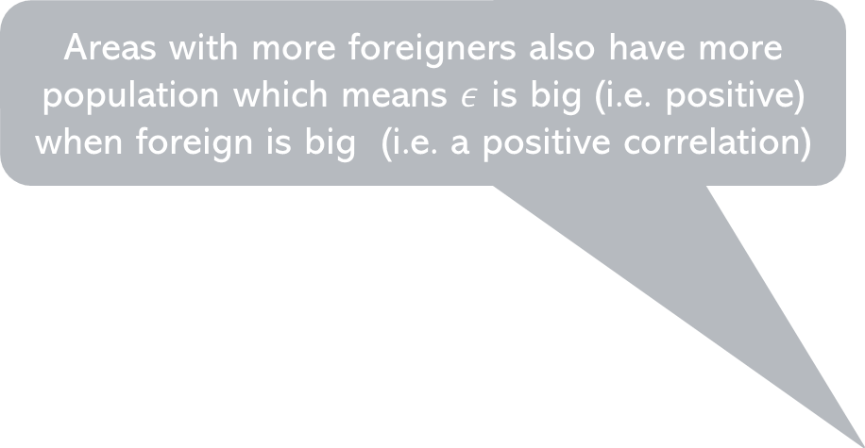
Confounding factors in the linear model: Consider population
$$Crime_{i}=β_{0}+β_{1}{foreign}_{i}+ε_{i}$$
+
+
Population
Areas with more foreigners also have more population which means $ε$ is big (i.e. positive) when foreign is big (i.e. a positive correlation)
$${Crime}_{i}=β_{0}+β_{1}{Foreigners}_{i}+ε_{i}$$
$${Crime}_{i}=\hat{β_{0}}+\hat{β_{1}}{Foreigners}_{i}+\hat{ε_{i}}$$
+
Estimated model
+
+
+
+
+
+
Crime
+
+
+
$$ε$$
+
+
+
True model
+
+
+
+
+
$$ε$$
+
+
+
+
+
+
+
+
+
+
+
+
+
+
+
+
Foreigners
If we estimate the true relationship by a trendline we overestimate the strength of the actual relationship; i.e. $β_{1}$is estimated with upward bias

Slide 30

Confounding factors in the linear model: Unemployment
$$Crime_{i}=β_{0}+β_{1}{foreign}_{i}+ε_{i}$$
+
-
Unemployment
When there are fewer foreigners there is more crime because of other factors (i.e. unemployment) captured in $ε$
True model
+
Estimated model
+
+
+
+
+
+
Crime
+
+
+
+
+
+
+
+
+
+
+
+
+
+
+
+
+
+
+
+
+
+
+
+
+
+
+
Foreigners
Hence we would underestimate the strength of the true relationship; i.e. downward bias

Slide 31

Takeaways
For good data analysis we have to be aware of:
The causal mechanisms we wish to study
The causal mechanism that is driving the data (The data story)
A clear description of these mechanisms (verbally, by arrows or formulas) constitutes the empirical model which helps us to organise the data analysis
Often the “data story” suggests reasons that could lead to biases in parameters we want to estimate
There can be upward bias and downward bias
Make sure you understand the notation of the linear model and how biases might affect it
For next time
Look at Exercise sheet 1
Try to install the R and Rstudio software packages (but don’t panic if you don’t manage)

